Slide 1
BLOOD BUCKET
A bucket of Blood Doners

Slide 2


Objective Of Blood Bucket
Connect
Blood Donors
Patient

Slide 3
Tools Used
Visual Studio
Bunifu UI
Microsoft Access
Adobe Illustrator
Adobe XD

Slide 4
Let’s see the User Interface and the Functions of Blood Bucket

Slide 5
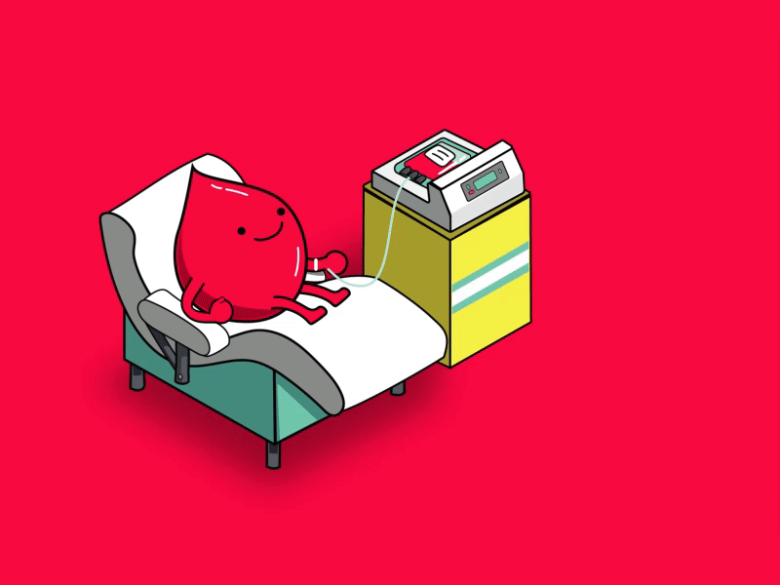
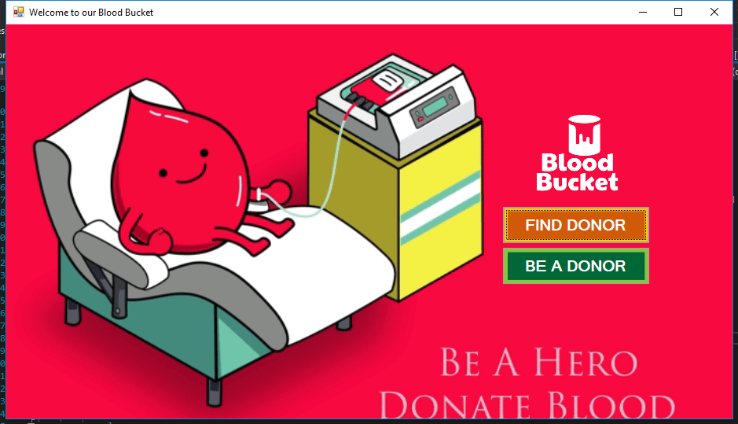
Welcome to our Blood Bucket
Here user can chose from two option. 1) Find Donor 2) Be a Donor

Slide 6
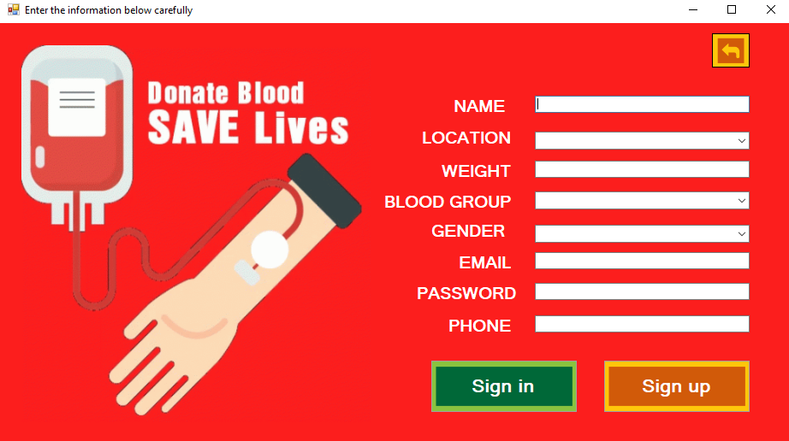

Be a Donor
Here user can register him/herself to become a donor

Slide 7
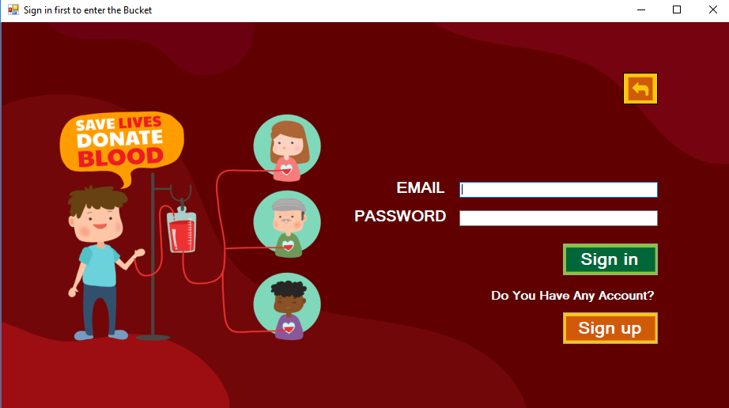
User Sign in
To find donor user has to sign in first to avoid any misuse of this system.

Slide 8
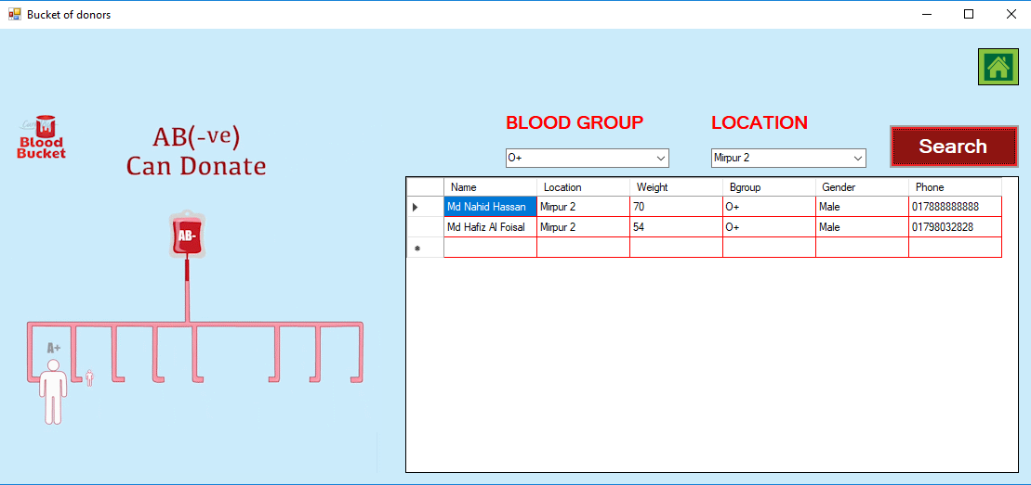
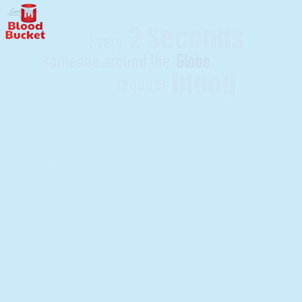
Find Donor
To find donor user has to select the blood type and the location.

Slide 9
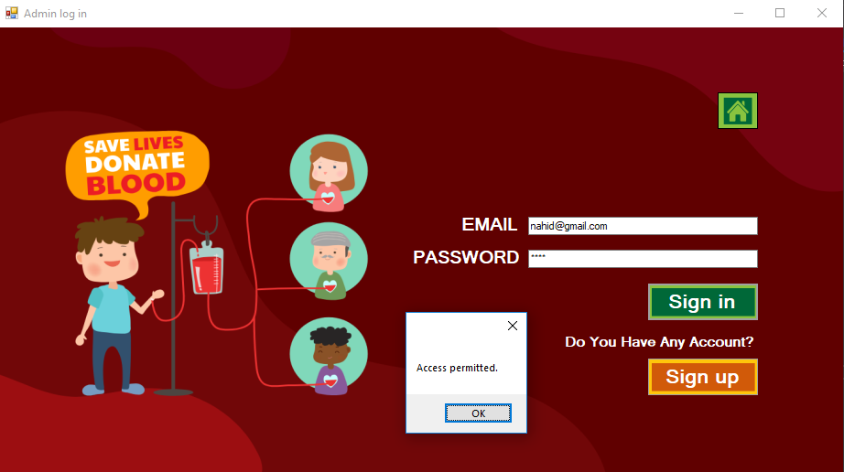
Admin Sign in
Only admin can access the back-end part and database of the system.

Slide 10
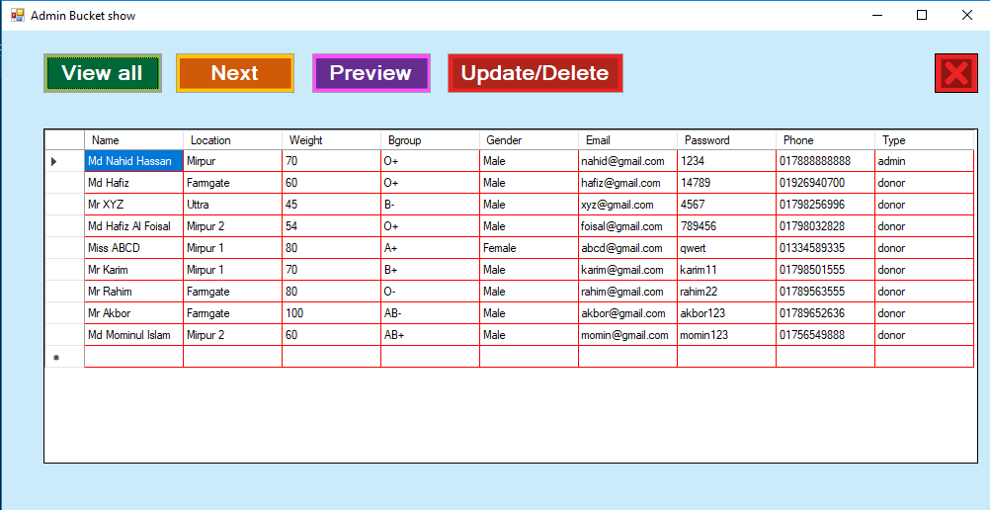
Database
Here admin can view all the information in the system database.

Slide 11
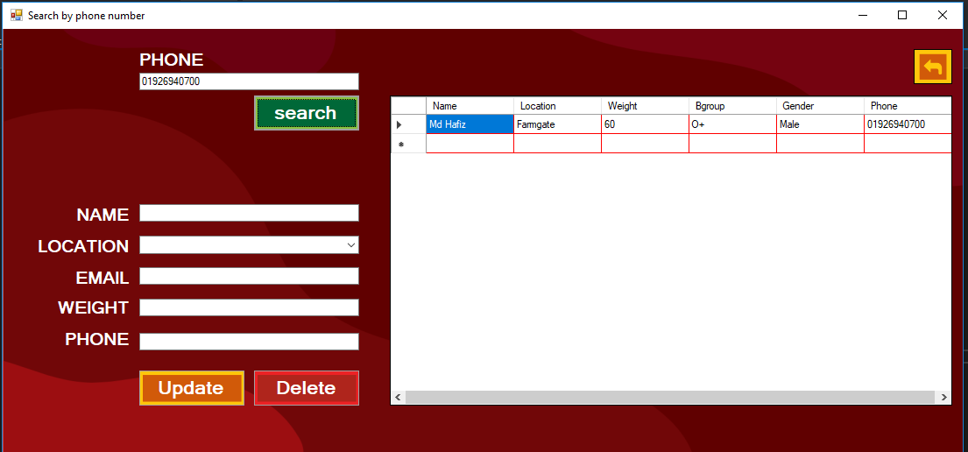
Update / delete
Here admin can search by phone number and chose to update or delete the information.

Slide 12
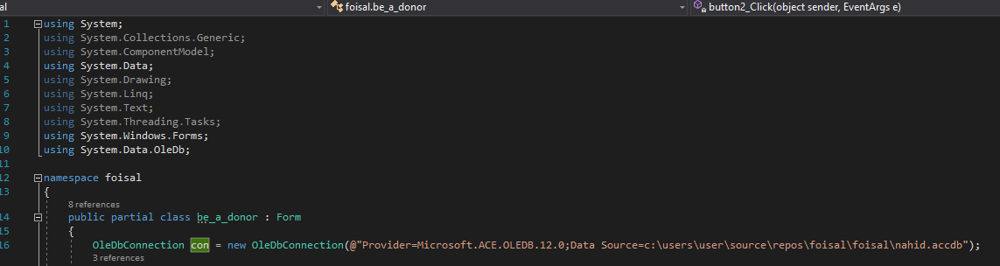
Database connection
This part of the code Connects the database to the system

Slide 13
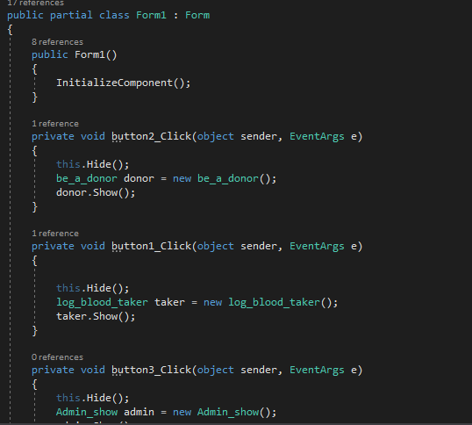
Welcome to our Blood Bucket
This part of the code contains the code to connect / redirecting form one form to another through button

Slide 14
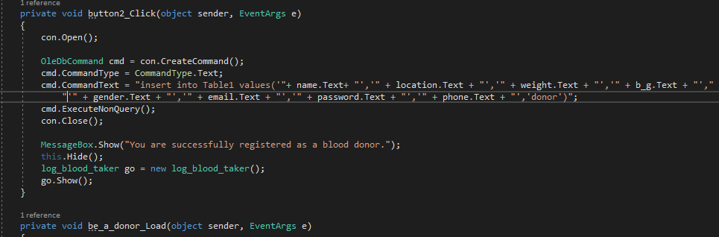
Be a Donor (Registration)
Here the data which are entered in the form by the user is inserted to the database.

Slide 15
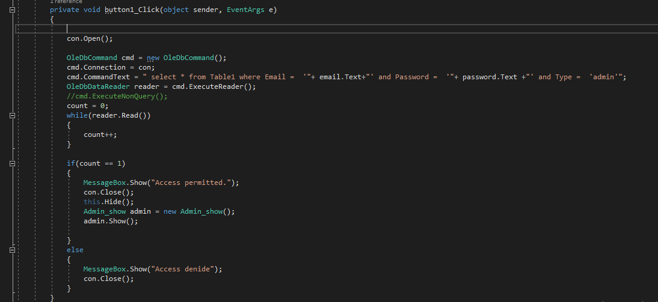
Admin Sign in
When the admin wants to enter the system the email and the password will be checked by this part of code

Slide 16
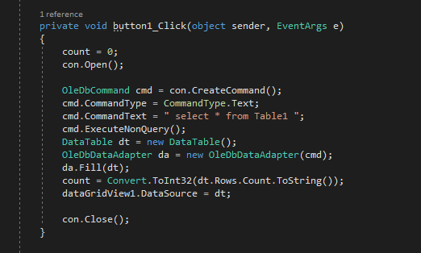
Database
This code allows the admin to see the entire data of the database

Slide 17
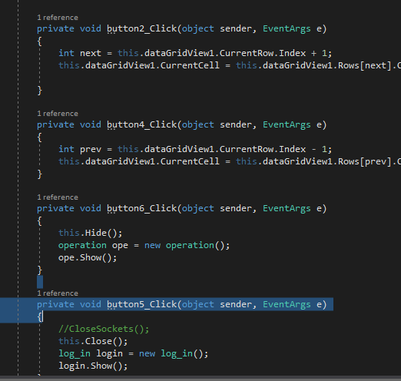
Next, Previous, Log Out
This part of the code allows admin to select next, previous data and also logout.

Slide 18
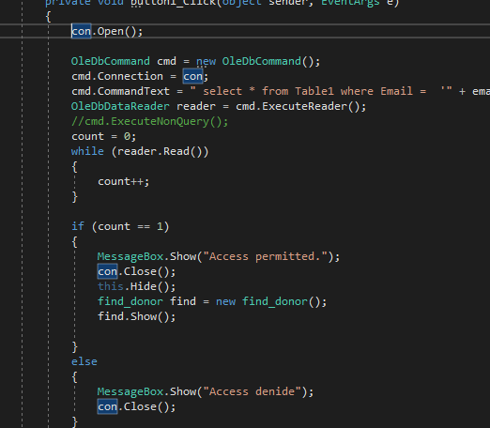
User Log in
This code confirms the log in process of user.

Slide 19
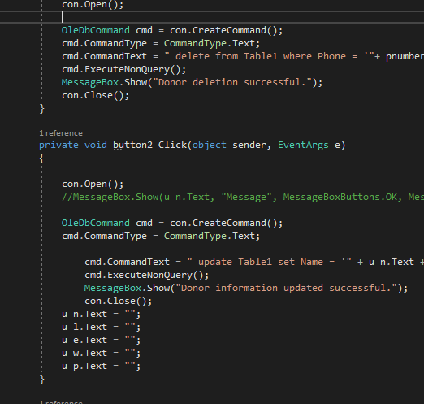
Update / Delete
To update or delete data from the database by the admin this code is executed.

Slide 20
Why Blood Bucket?
There are a lots of blood donation organization/ services around our country. One or two organization cant fulfill the demand of this over populated country. As around 600 thousand units of blood were collected under public and private sectors. Blood bucket is just a helping hand to this blood donation community for better word.

Slide 21
Future of Blood Bucket
Enrich database
Available search for all cities
Control the blood transaction between user & patient
Online
Real-time information about the user or donor

Slide 22
Objectives
To make a vast sphere in Blood Donation field.

Slide 23
Thank you !

